Slide 1
그림으로 보는 Deep Neural Network 근 현대사
불필요한 노동에서 해방되고자, 다양한 자료를 인용했습니다. 원작자님들에게 감사의 말을 드립니다.
Name: 이충기 (Chungki Lee)
Email: cklee.brain@gmail.com; chungki.lee@samsung.com
https://github.com/chungbrain

Slide 2
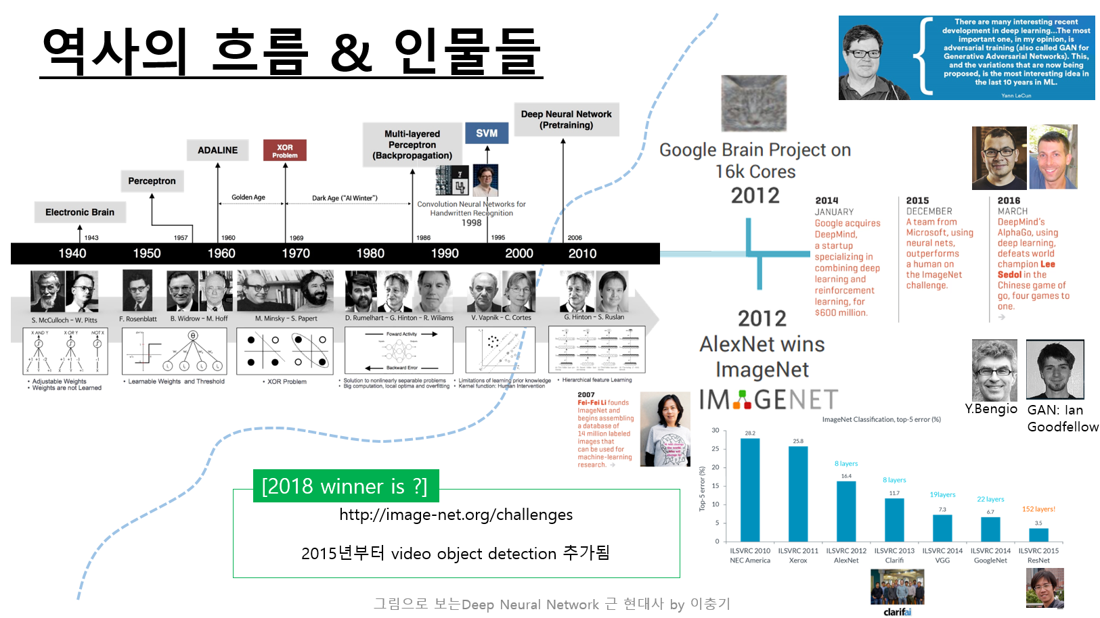
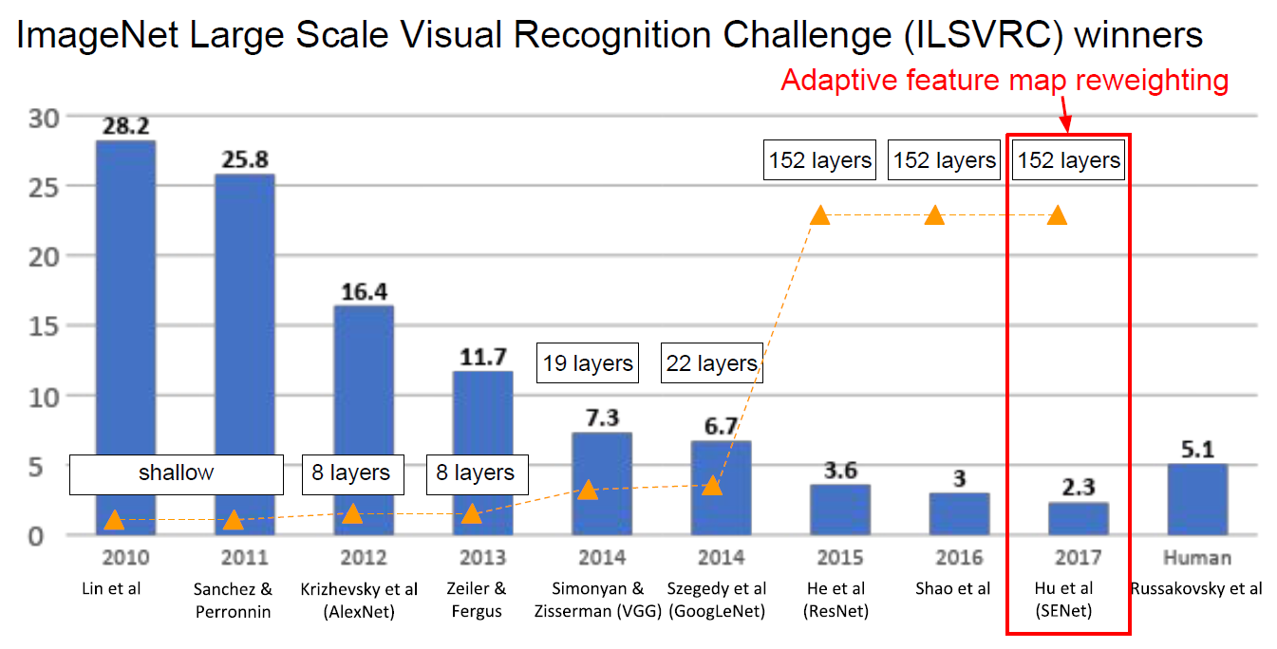

Slide 3
Neural Network (NN) 의 핵심 기술들
Back propagation : 너무 기초라서 패스
CNN
Batch Normalization
Dropout (DropConnection)
Data augmentation
Weight initialization
Pooling
Activation Func.
* 나열된 항목들은 뒤 슬라이드에 모두 다룰 것임

Slide 4
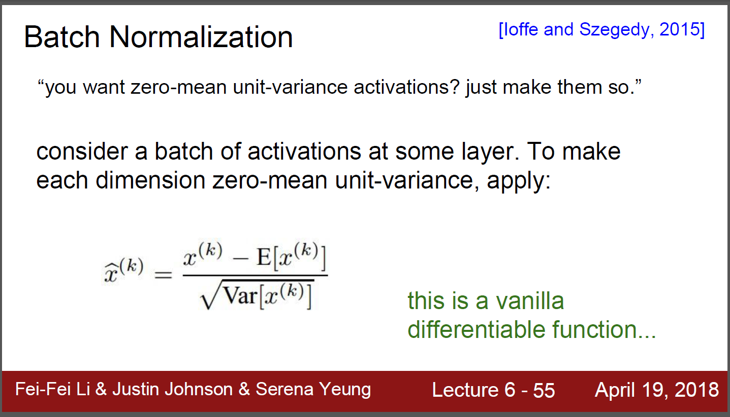
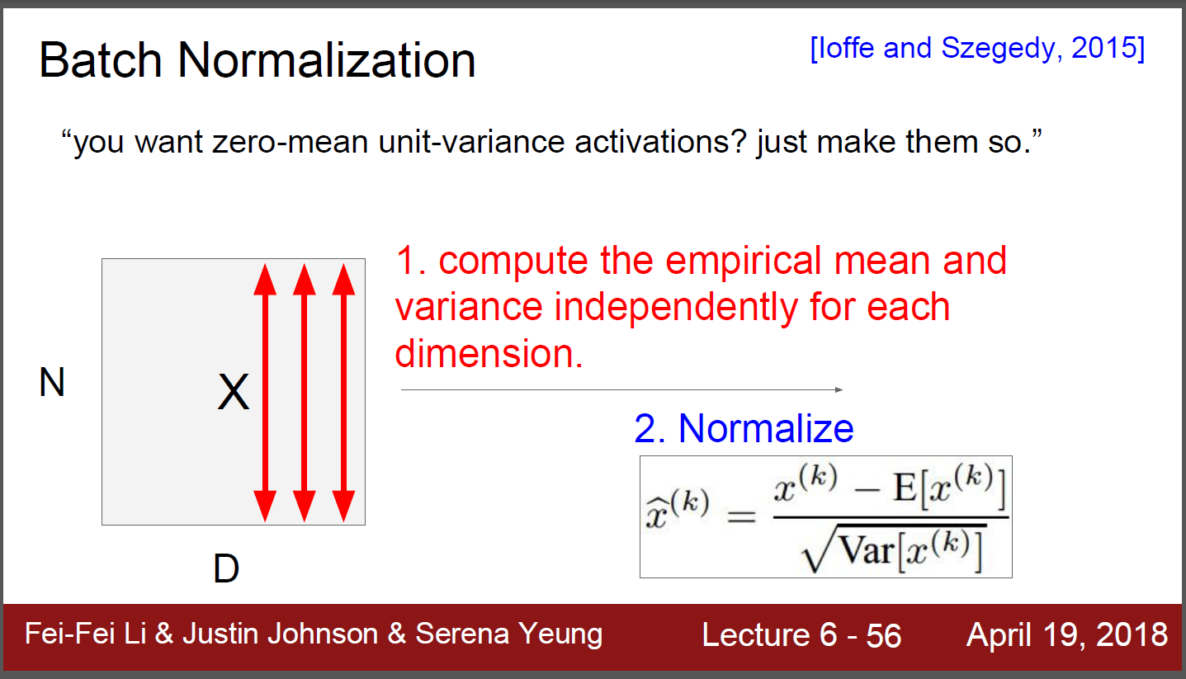
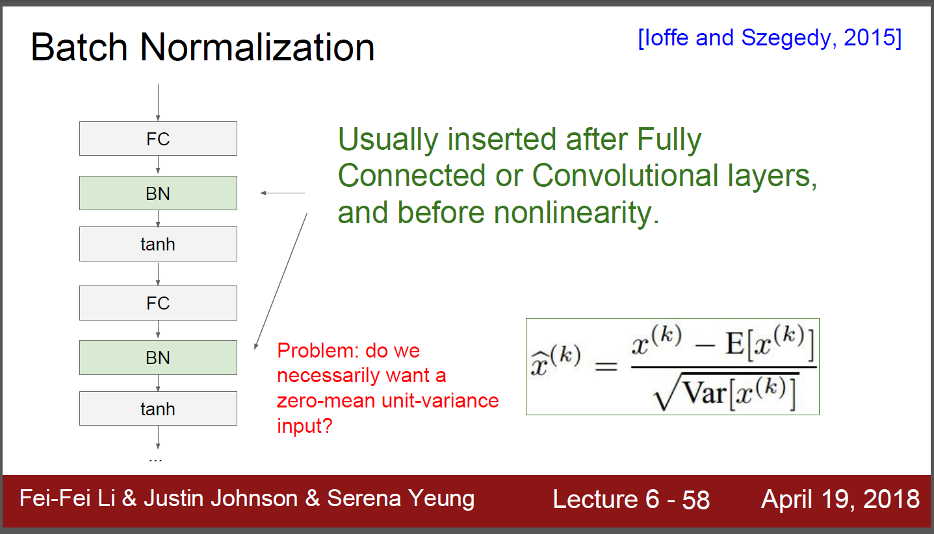
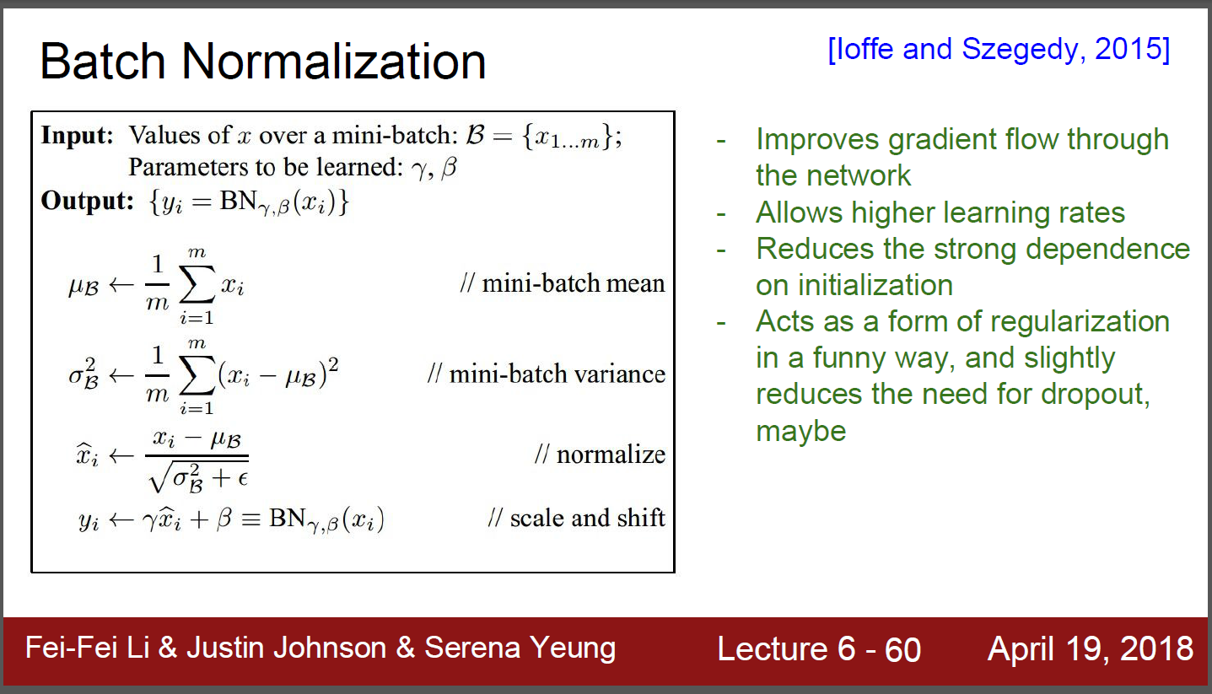
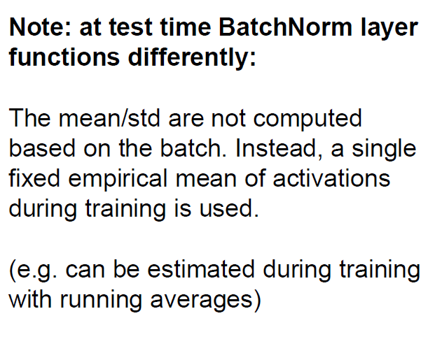
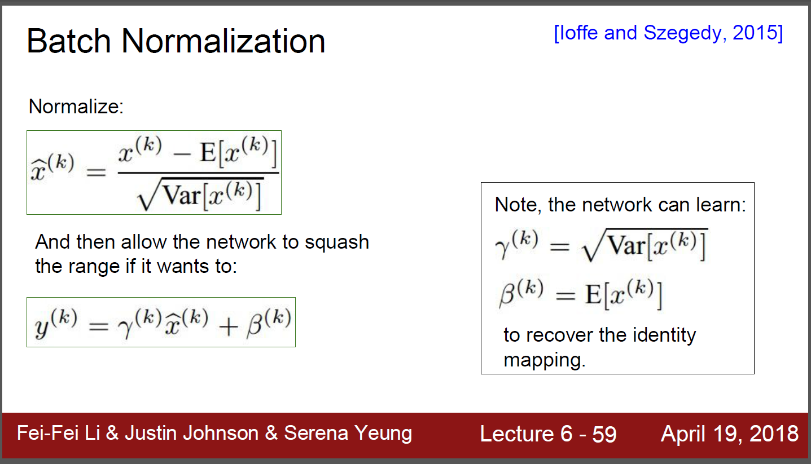
Batch normalization

Slide 5
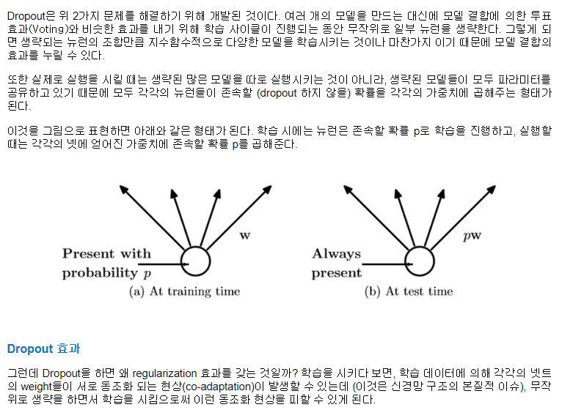
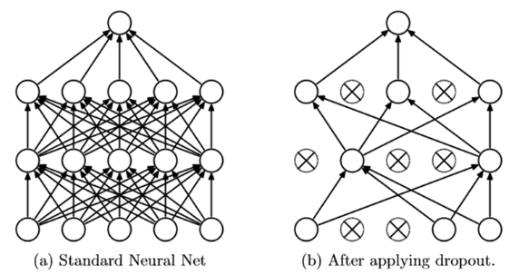
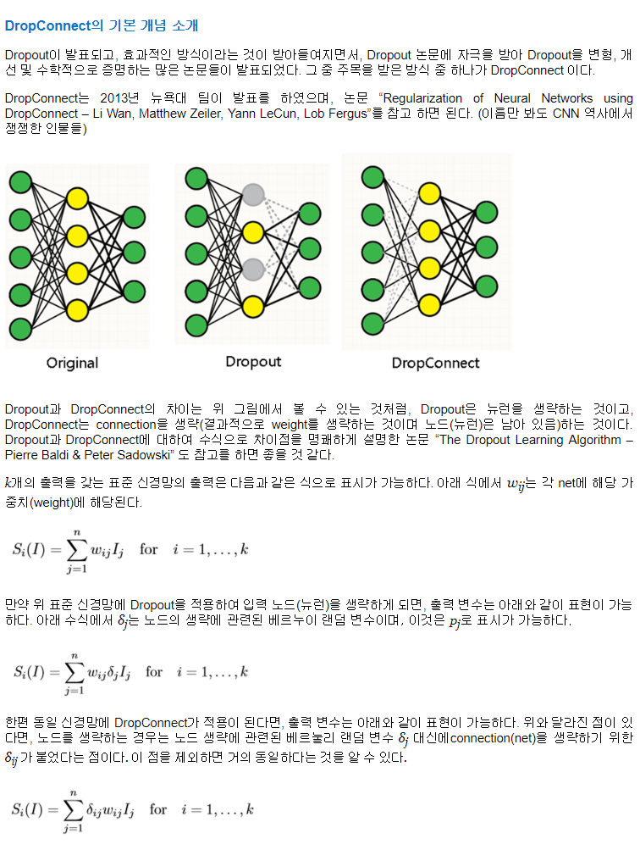
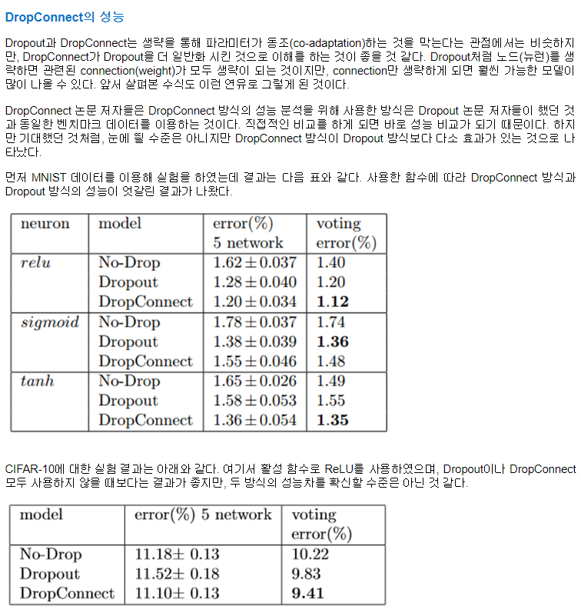
DropOut/DropConnect: for regularization
DropOut

Slide 6
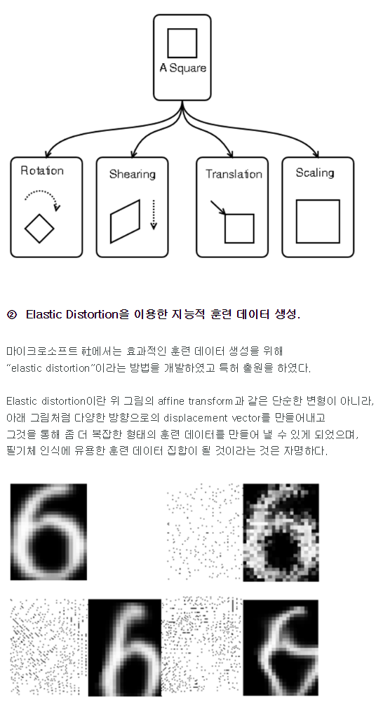
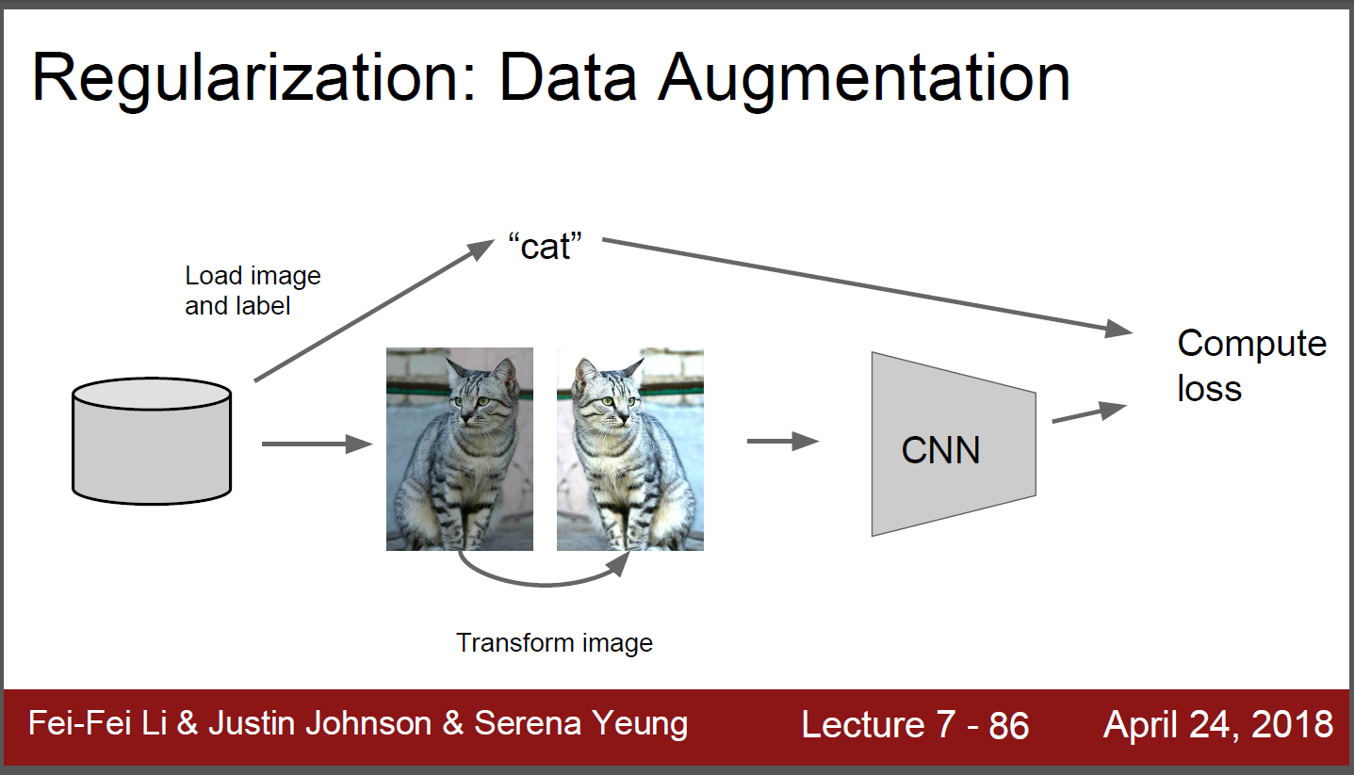
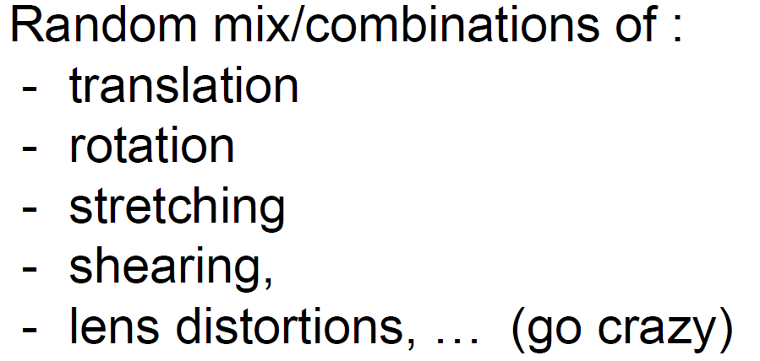
Data augmentation

Slide 7
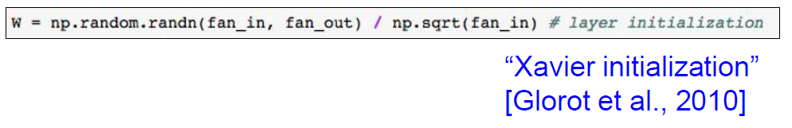
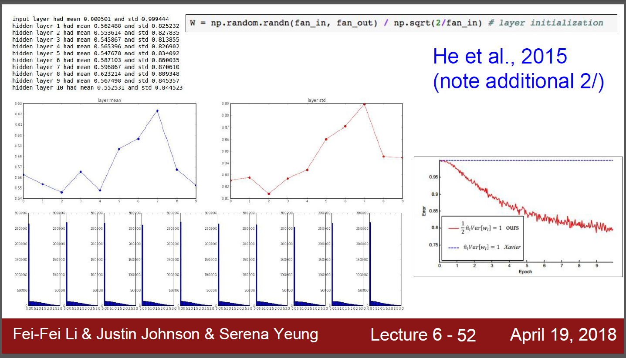
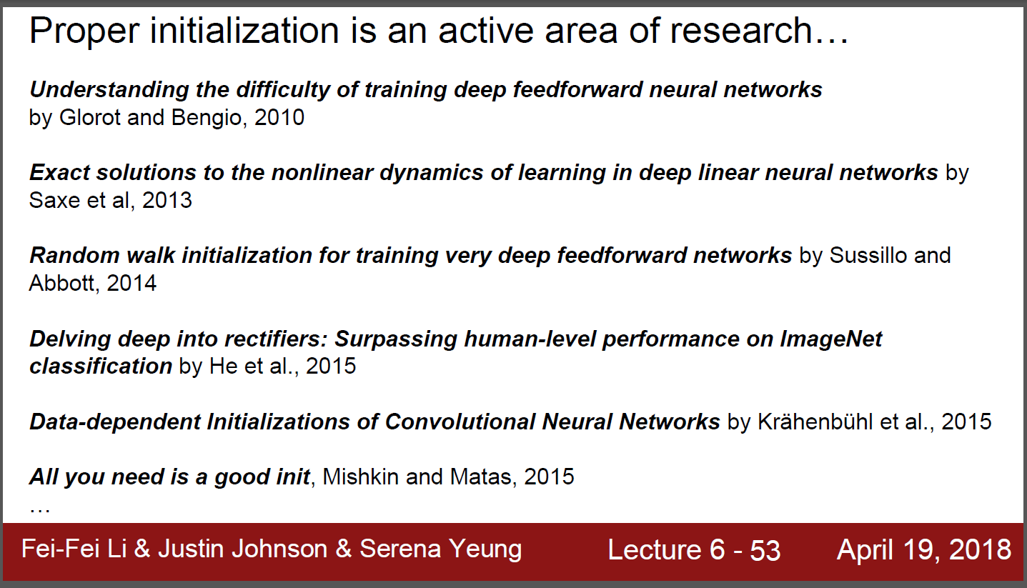
Weight initialization

Slide 8
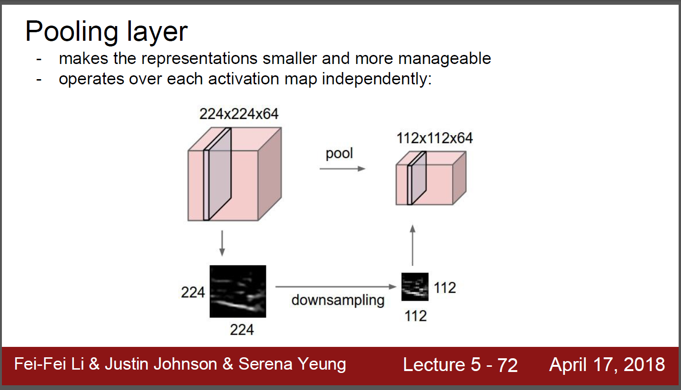
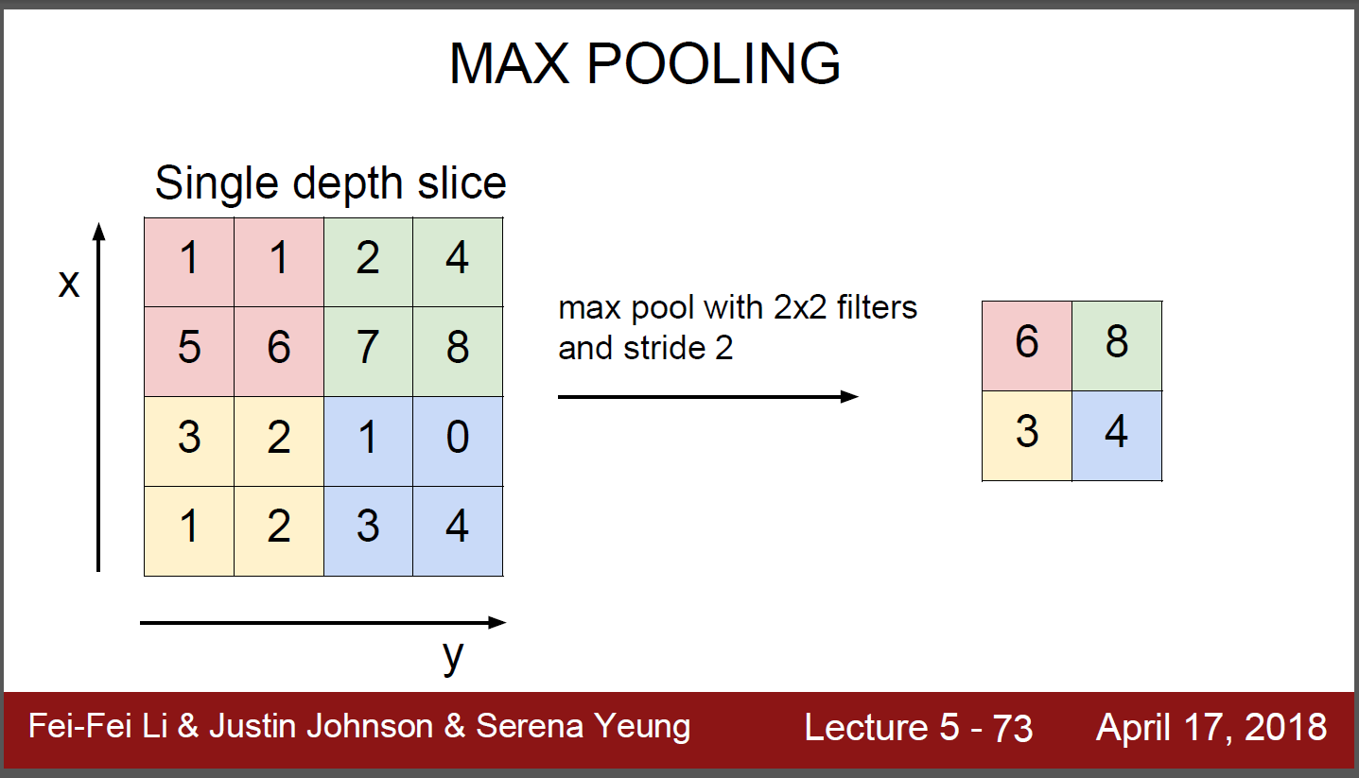
Pooling

Slide 9
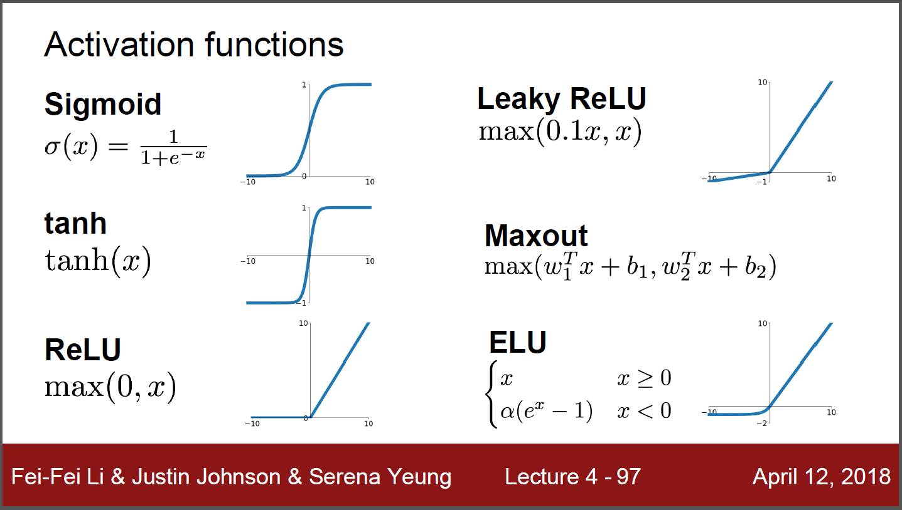
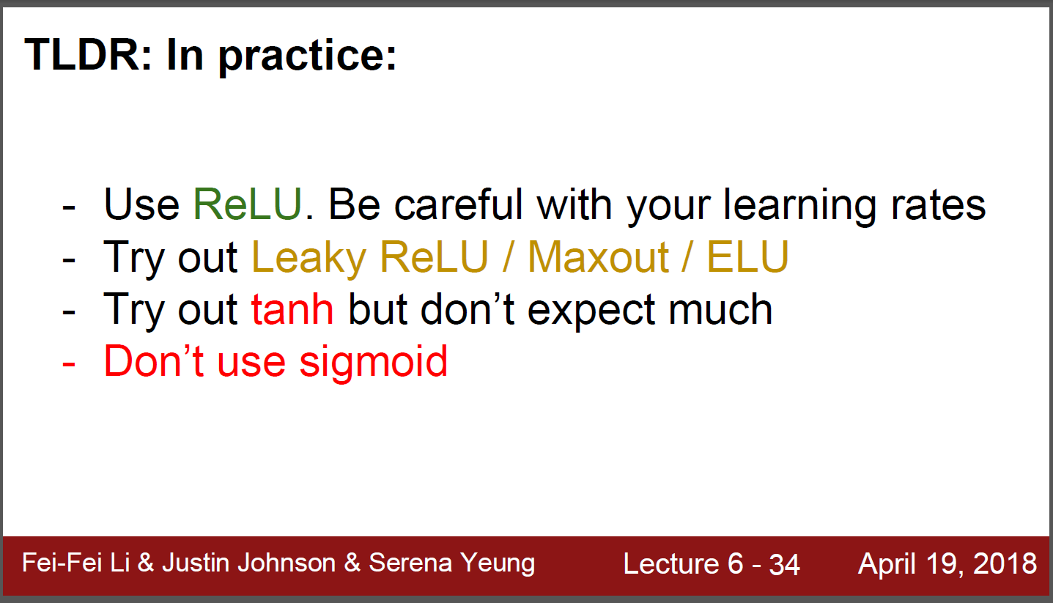
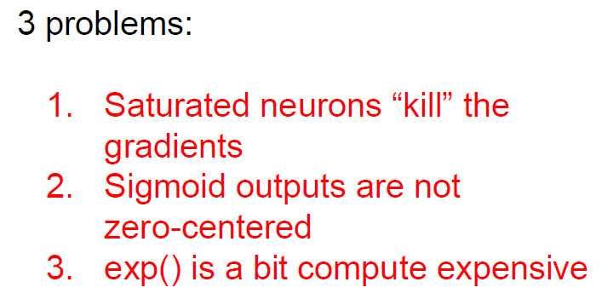
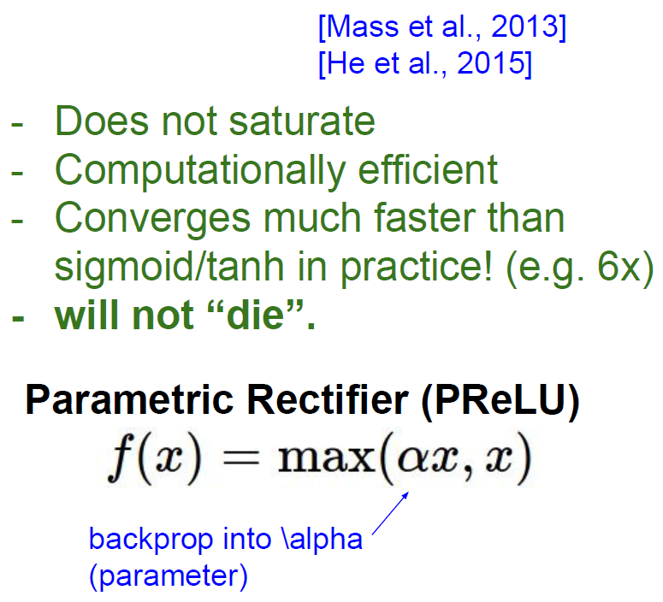
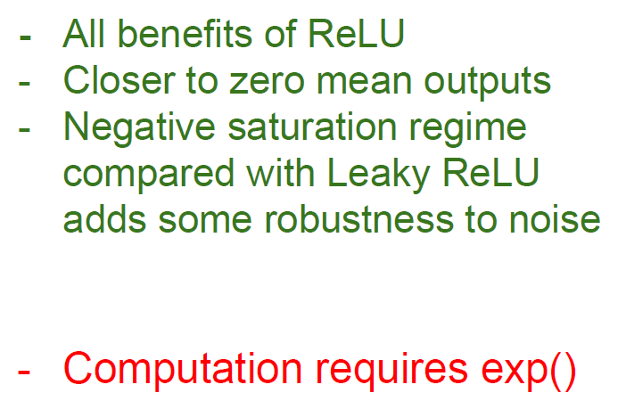
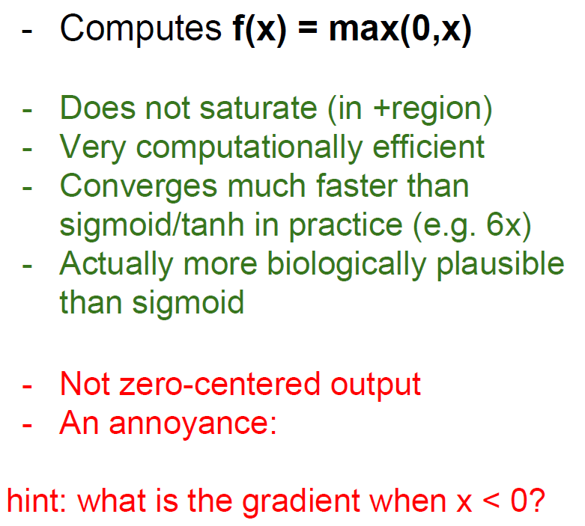
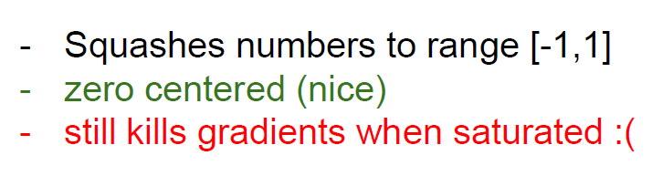
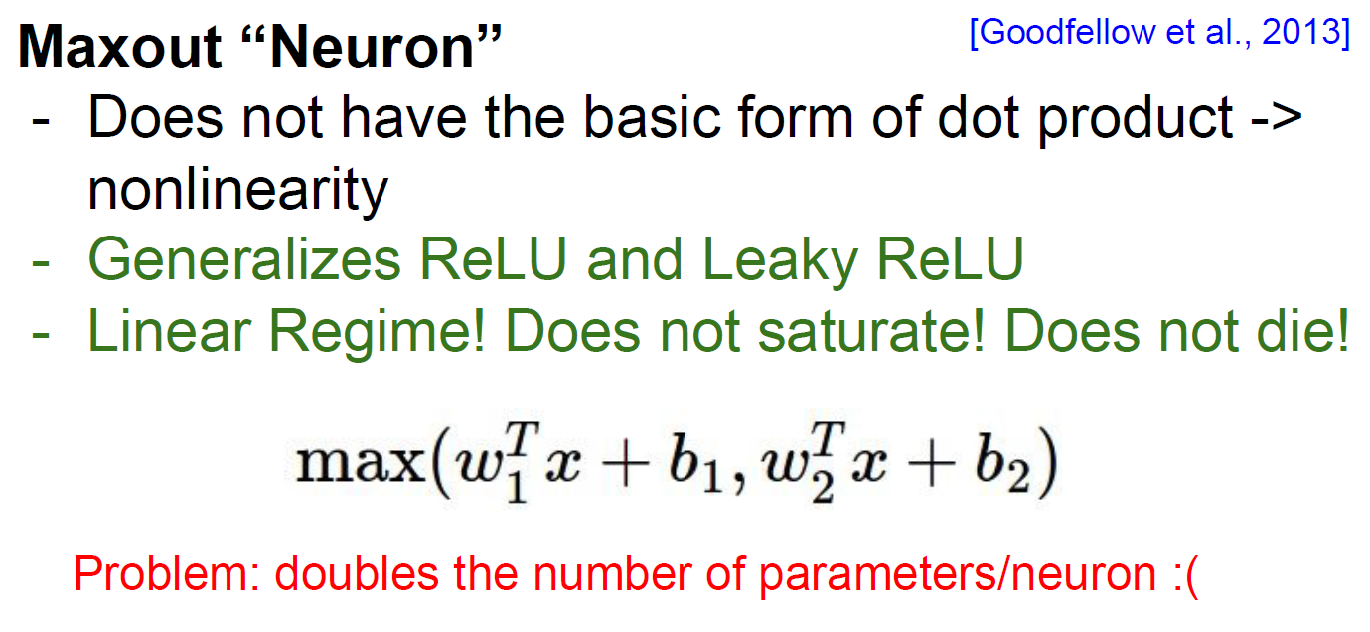
K
ReLU
Leaky ReLU
ELU
of sigmoid
Pros and cons in tanh

Slide 10
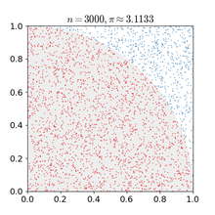
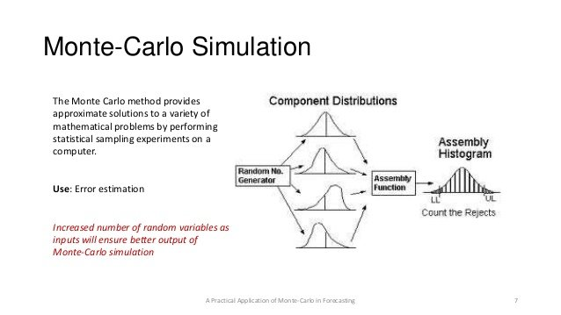
이해를 돕기 위한 기타 정보들
Monte Carlo method
1x1 convolution(inception)
Cross entropy cost function
Softmax
Bagging/adaboost
Conditional random field (CRF) for semantic segmentation
Markov chain monte carlo (MCMC)
Convolution arithmetic (https://github.com/vdumoulin/conv_arithmetic)
Stochastic Gradient Decent (SGD), SGD + Momentum, Adam
Gradient/Jacobian/Hessian/Laplacian
Transfer learning with CNNs

Slide 11
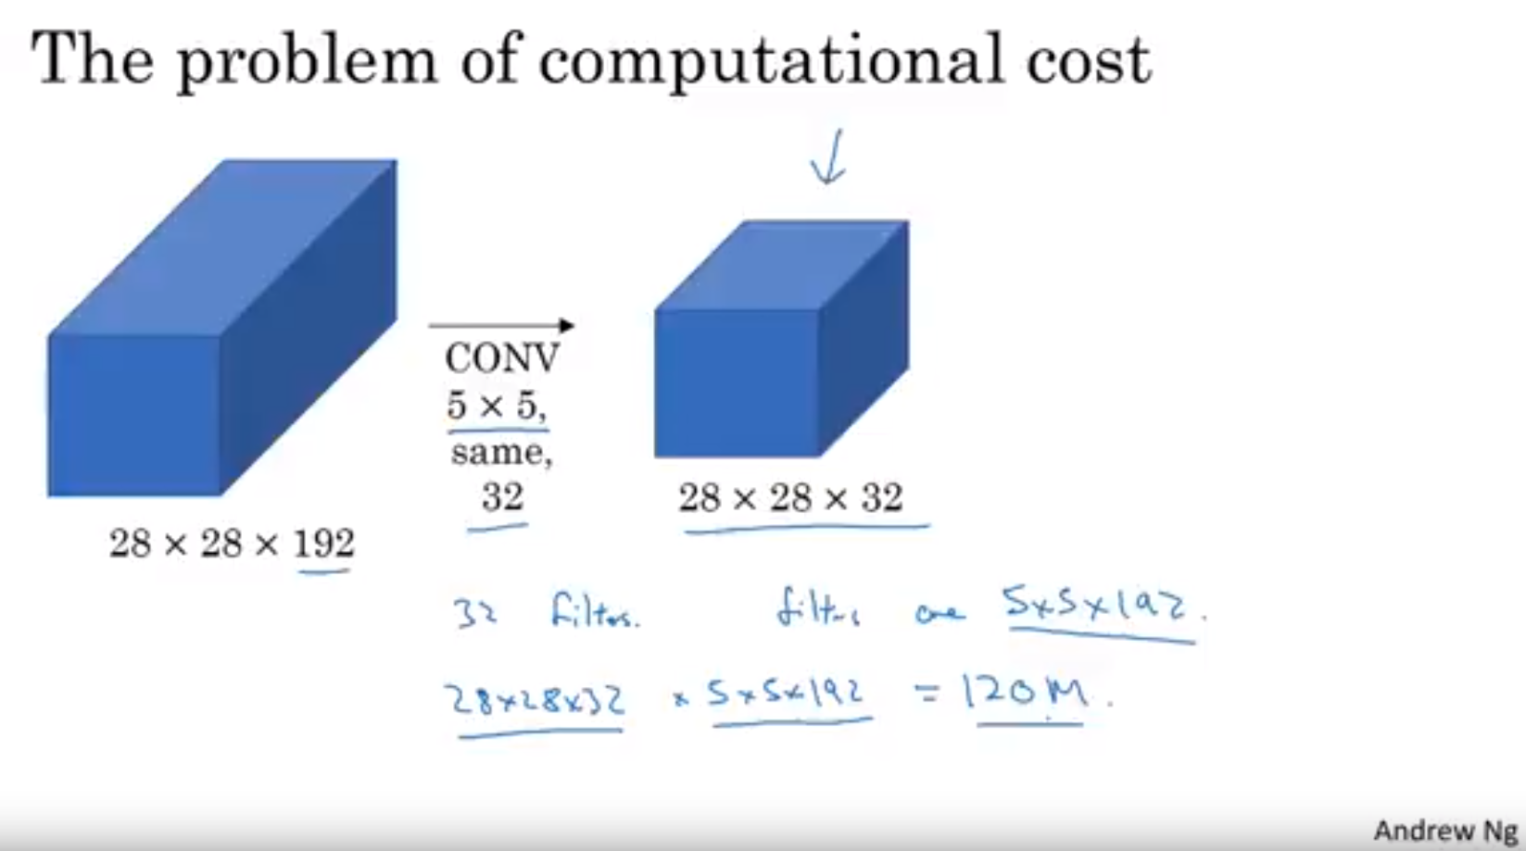
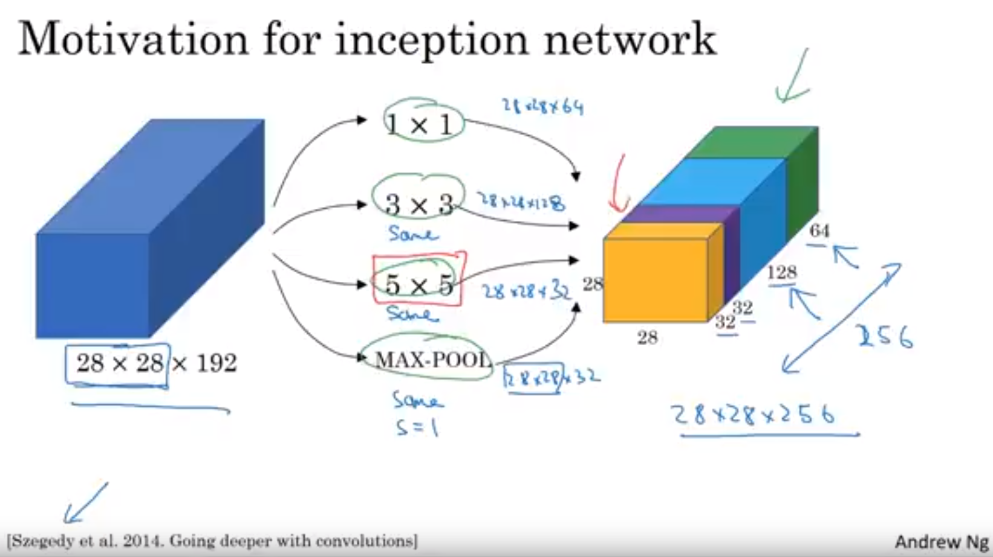
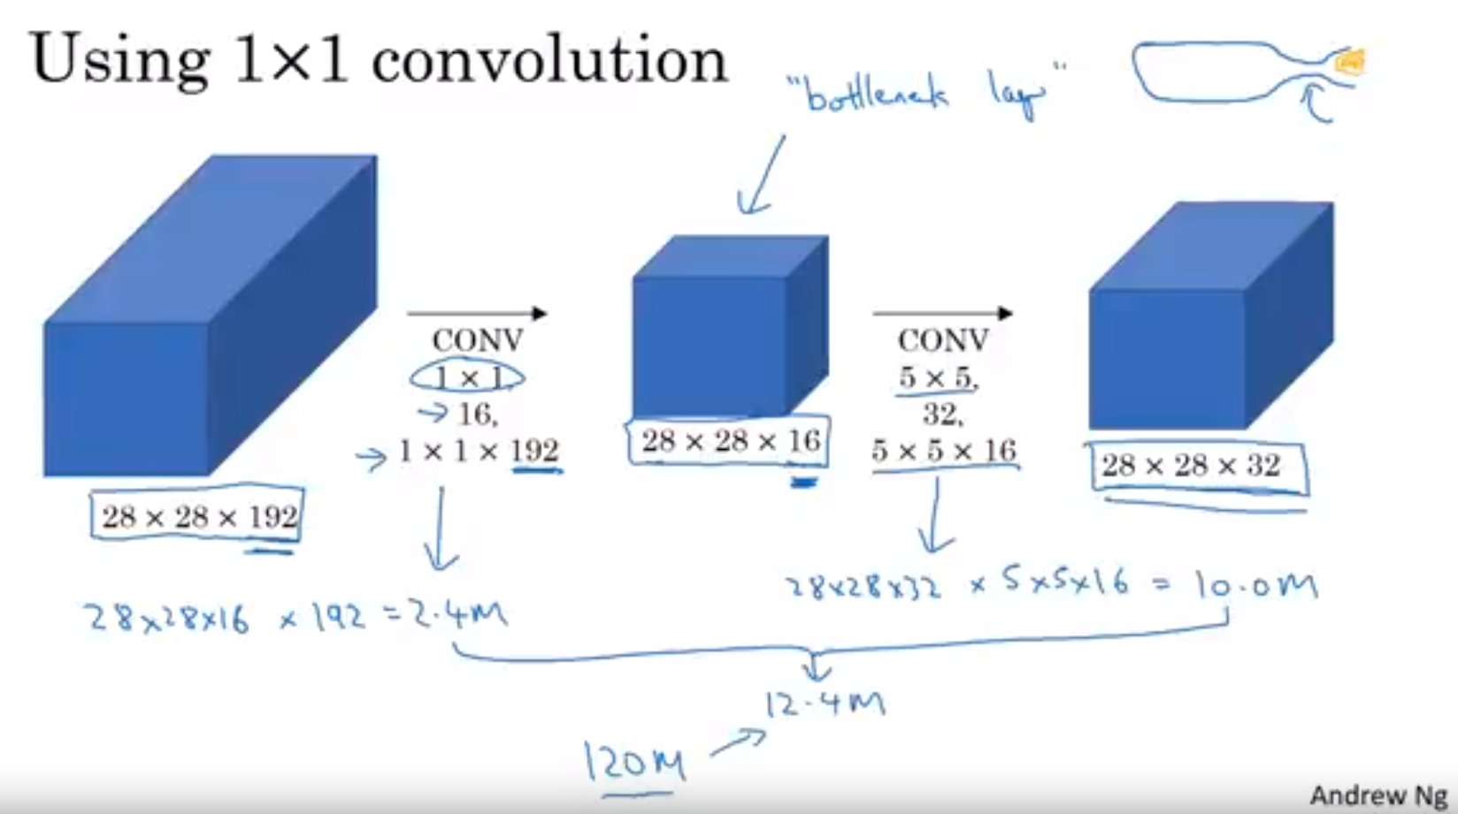
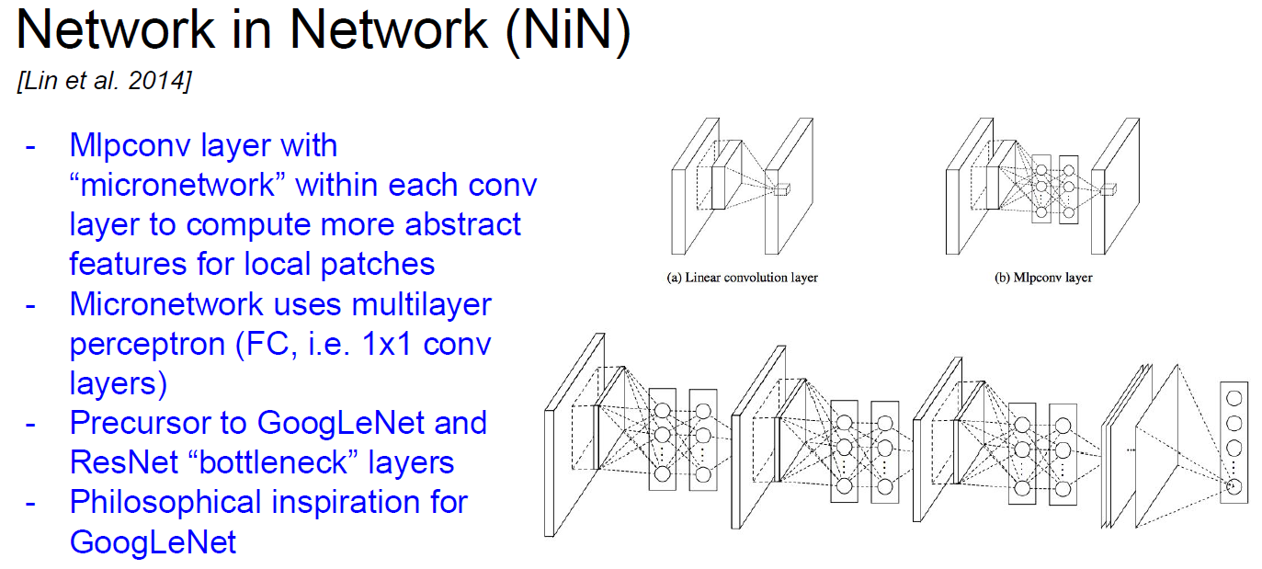
1x1 Convolution

Slide 12
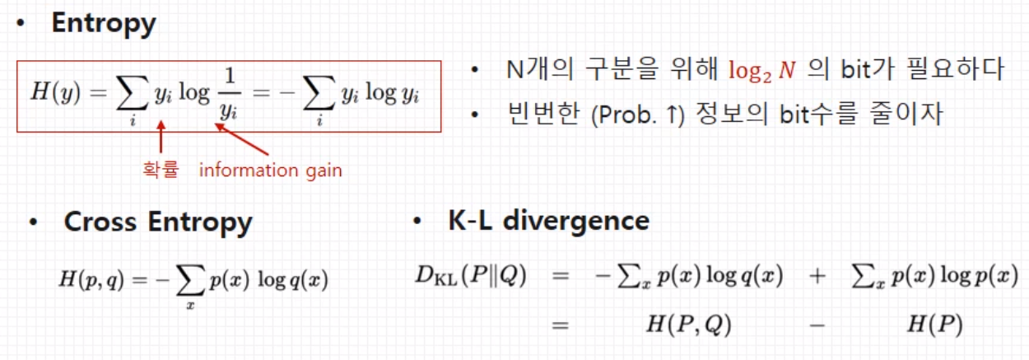
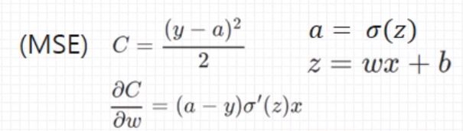
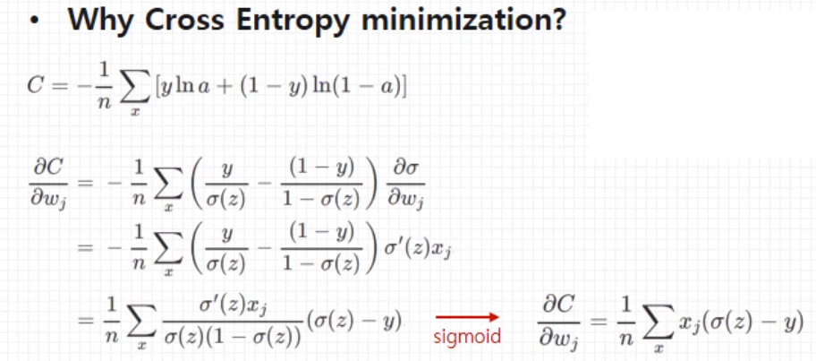
Cross entropy cost function
아래 잘 정리되어 있음 (https://youtu.be/uMYhthKw1PU), https://youtu.be/rtD0RvfBJqQ
반면에 mean square error(MSE)는 activation function (δ’) 이 saturation 되었을 때 (숫자 0 에 근접할 때) backpropagation 힘들게 된다.
https://youtu.be/rtD0RvfBJqQ
Cross entropy가 logistic regression과 결합되게 되고
Minimizing C 값을 구할 때 미분된 (δ’) 값이 아니라, (δ)-y 차이가 gradient descent에 적용되어 계산된다.

Slide 13
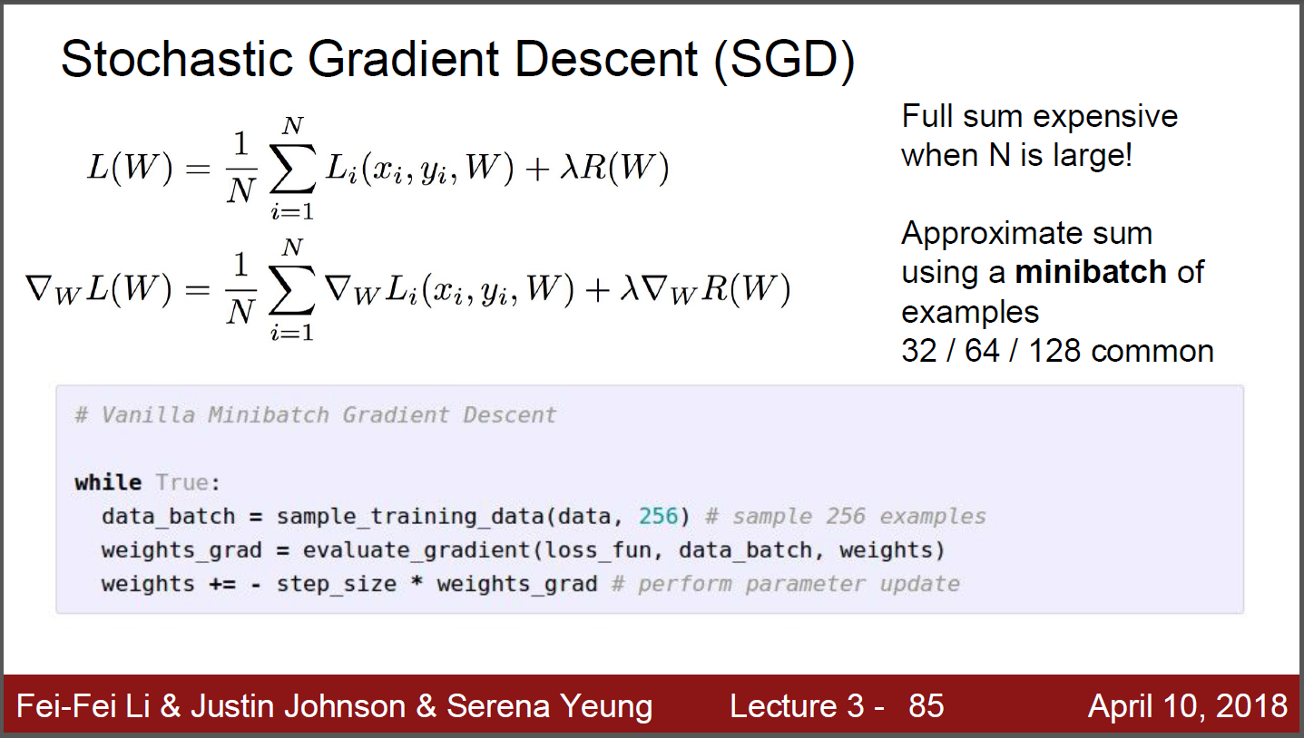
SGD

Slide 14
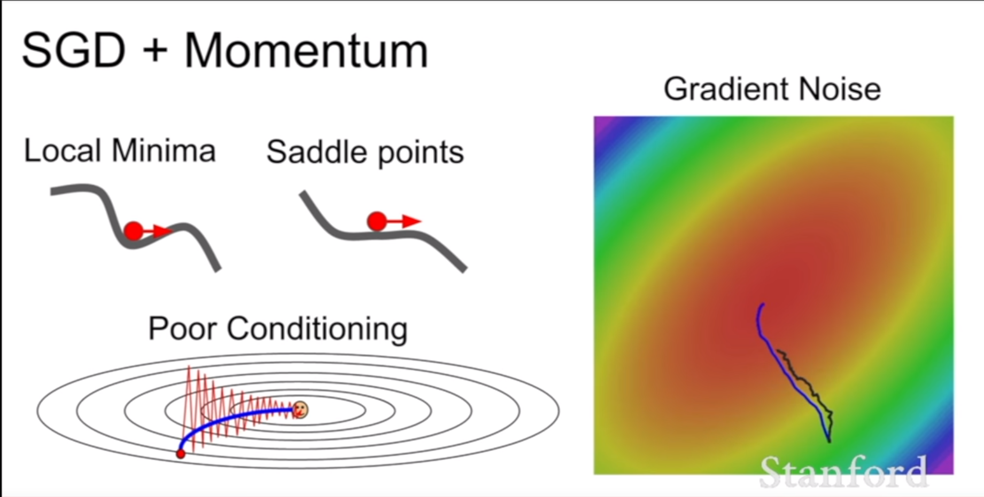
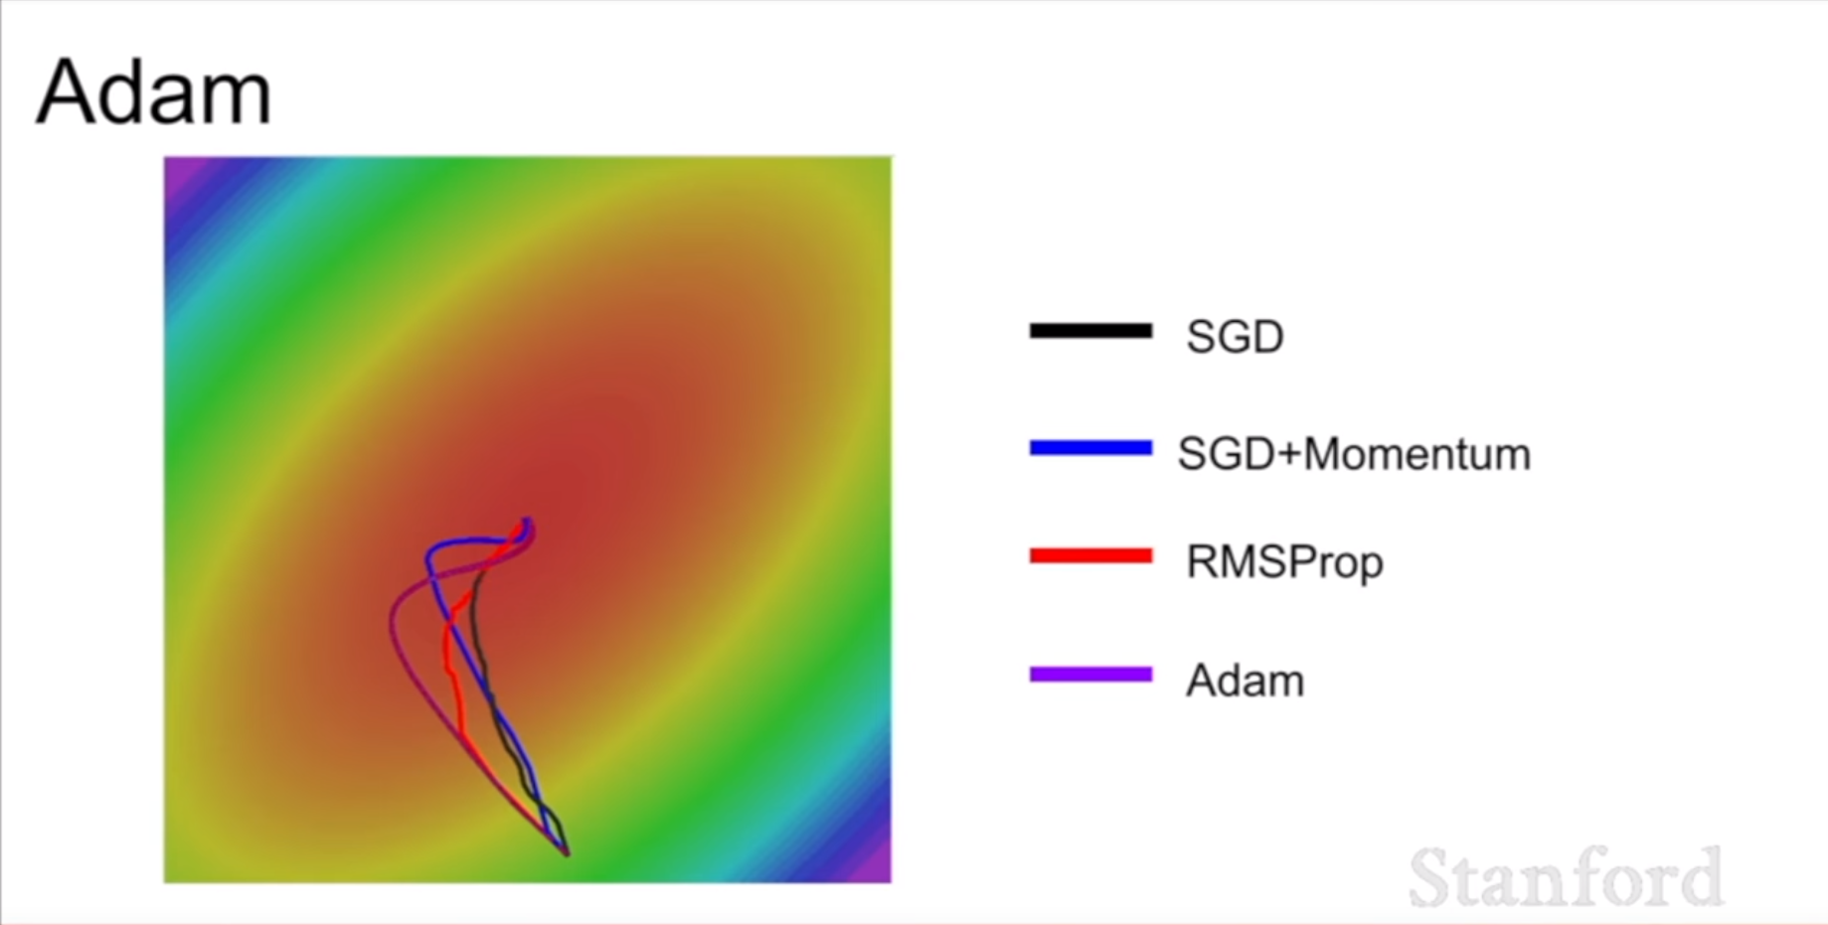
Adam
Cs231n_2018 lecture07 참고 https://youtu.be/_JB0AO7QxSA

Slide 15
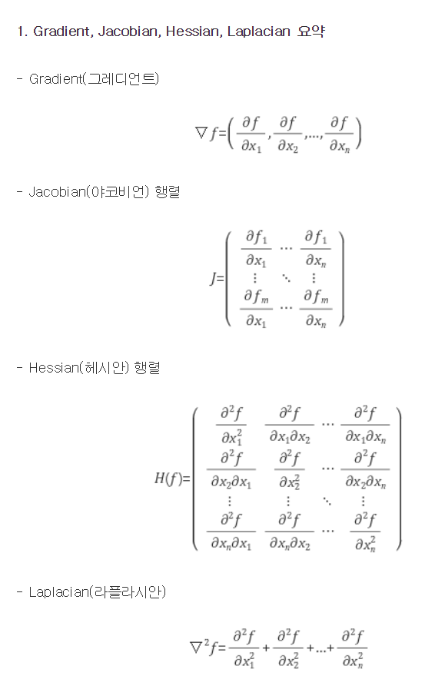
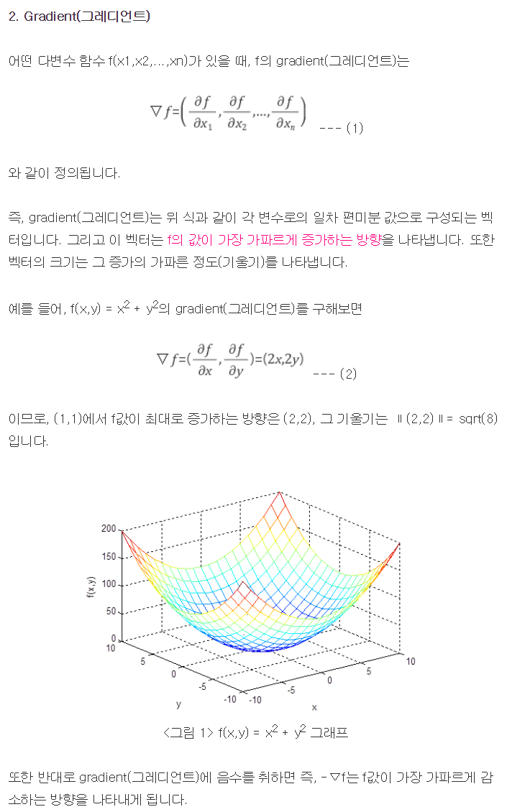
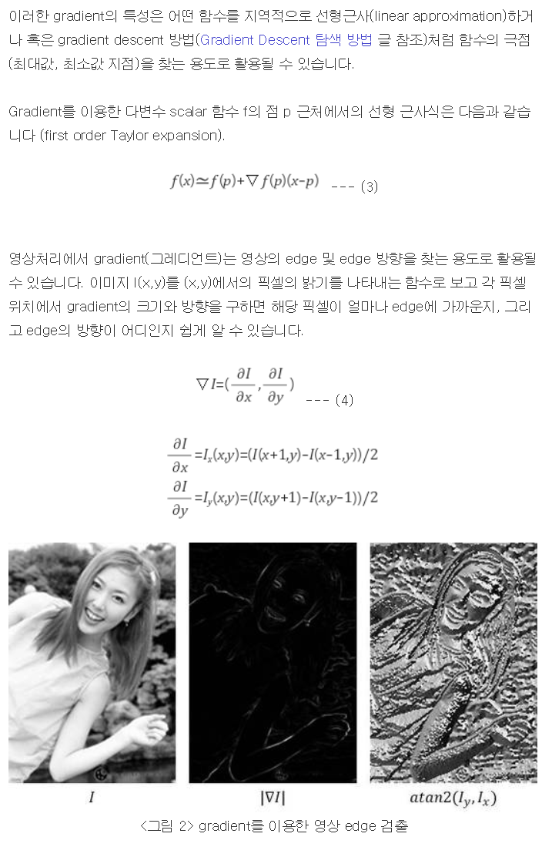
Gradient/Jacobian/Hessian/Laplacian
http://darkpgmr.tistory.com/132

Slide 16
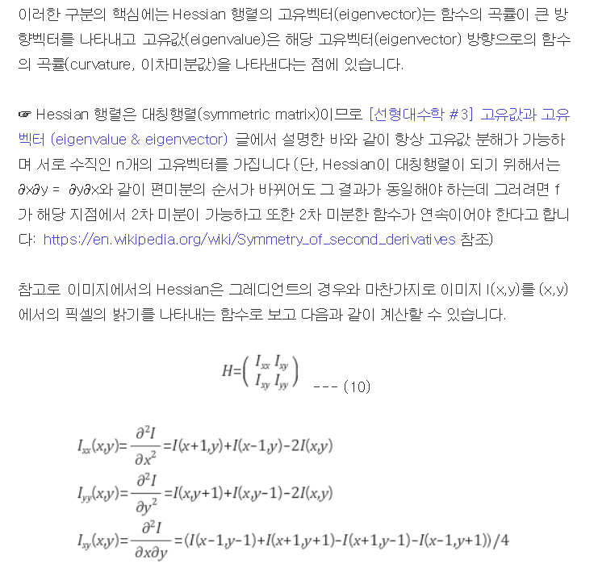
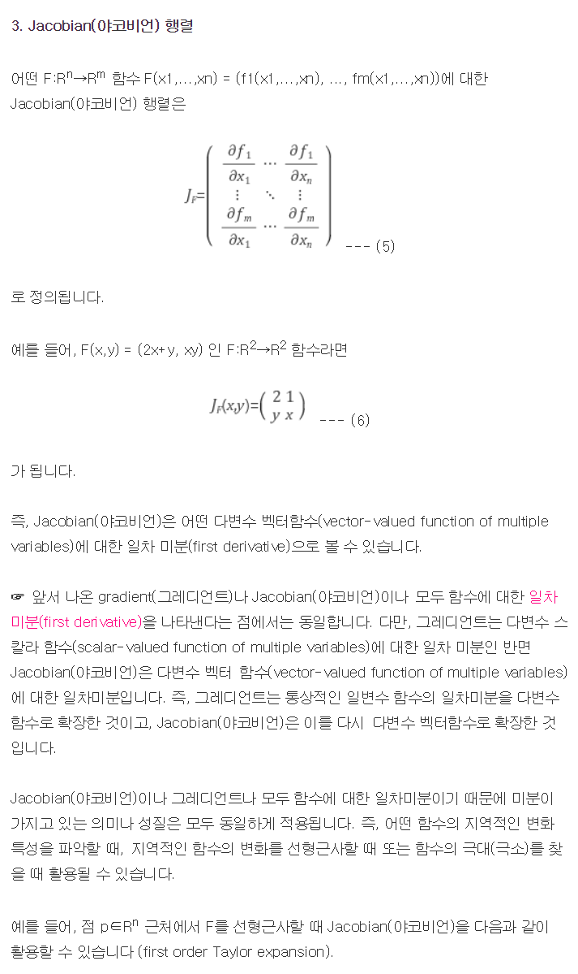
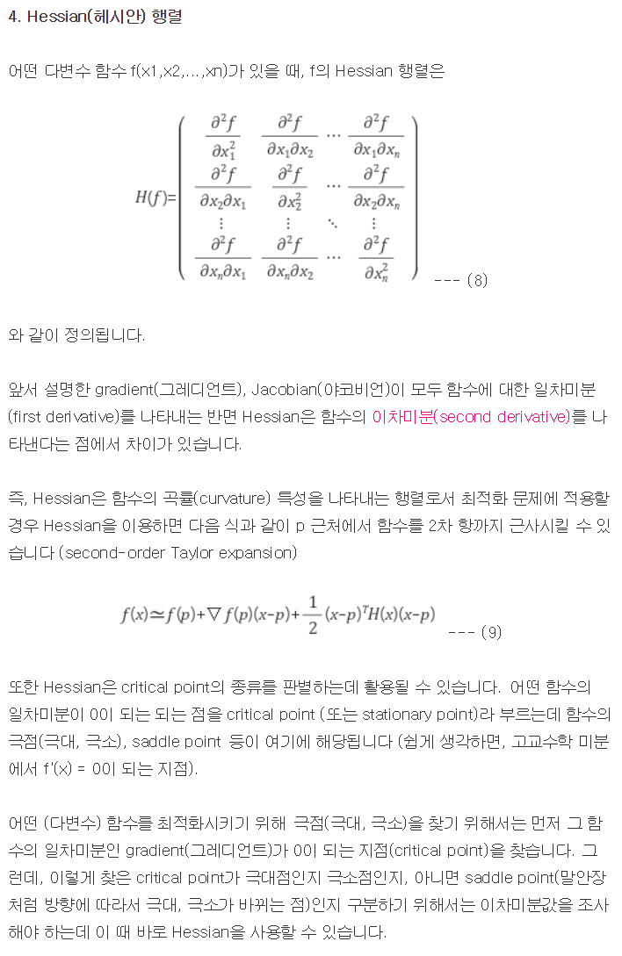
Gradient/Jacobian/Hessian/Laplacian
http://darkpgmr.tistory.com/132

Slide 17
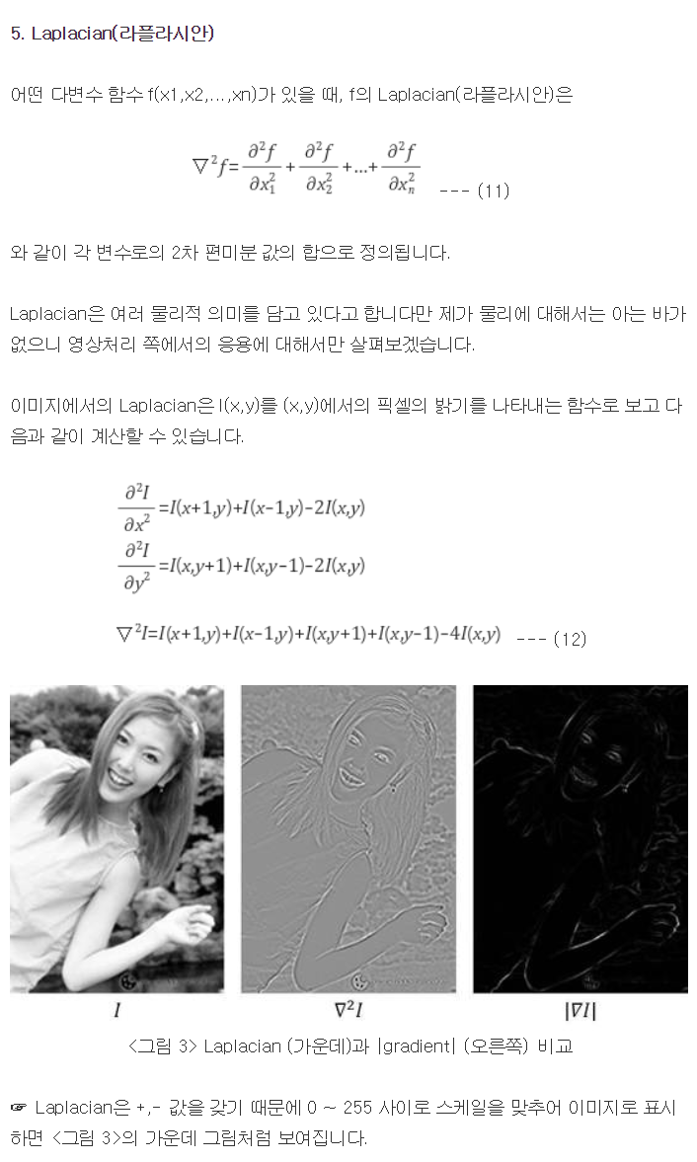
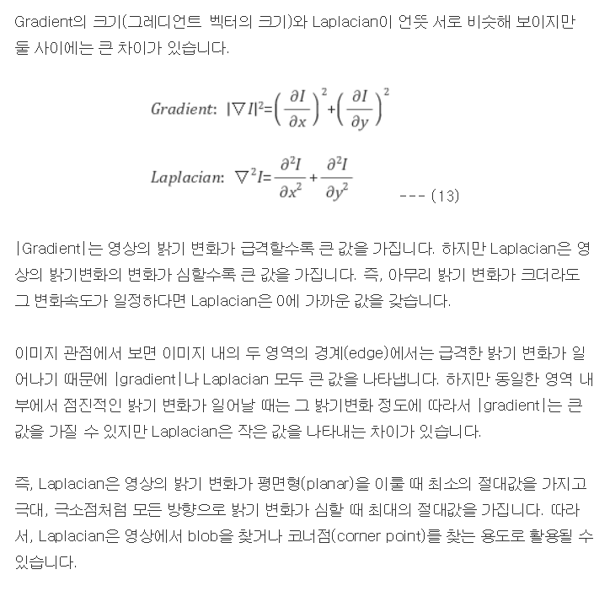
Gradient/Jacobian/Hessian/Laplacian
http://darkpgmr.tistory.com/132

Slide 18
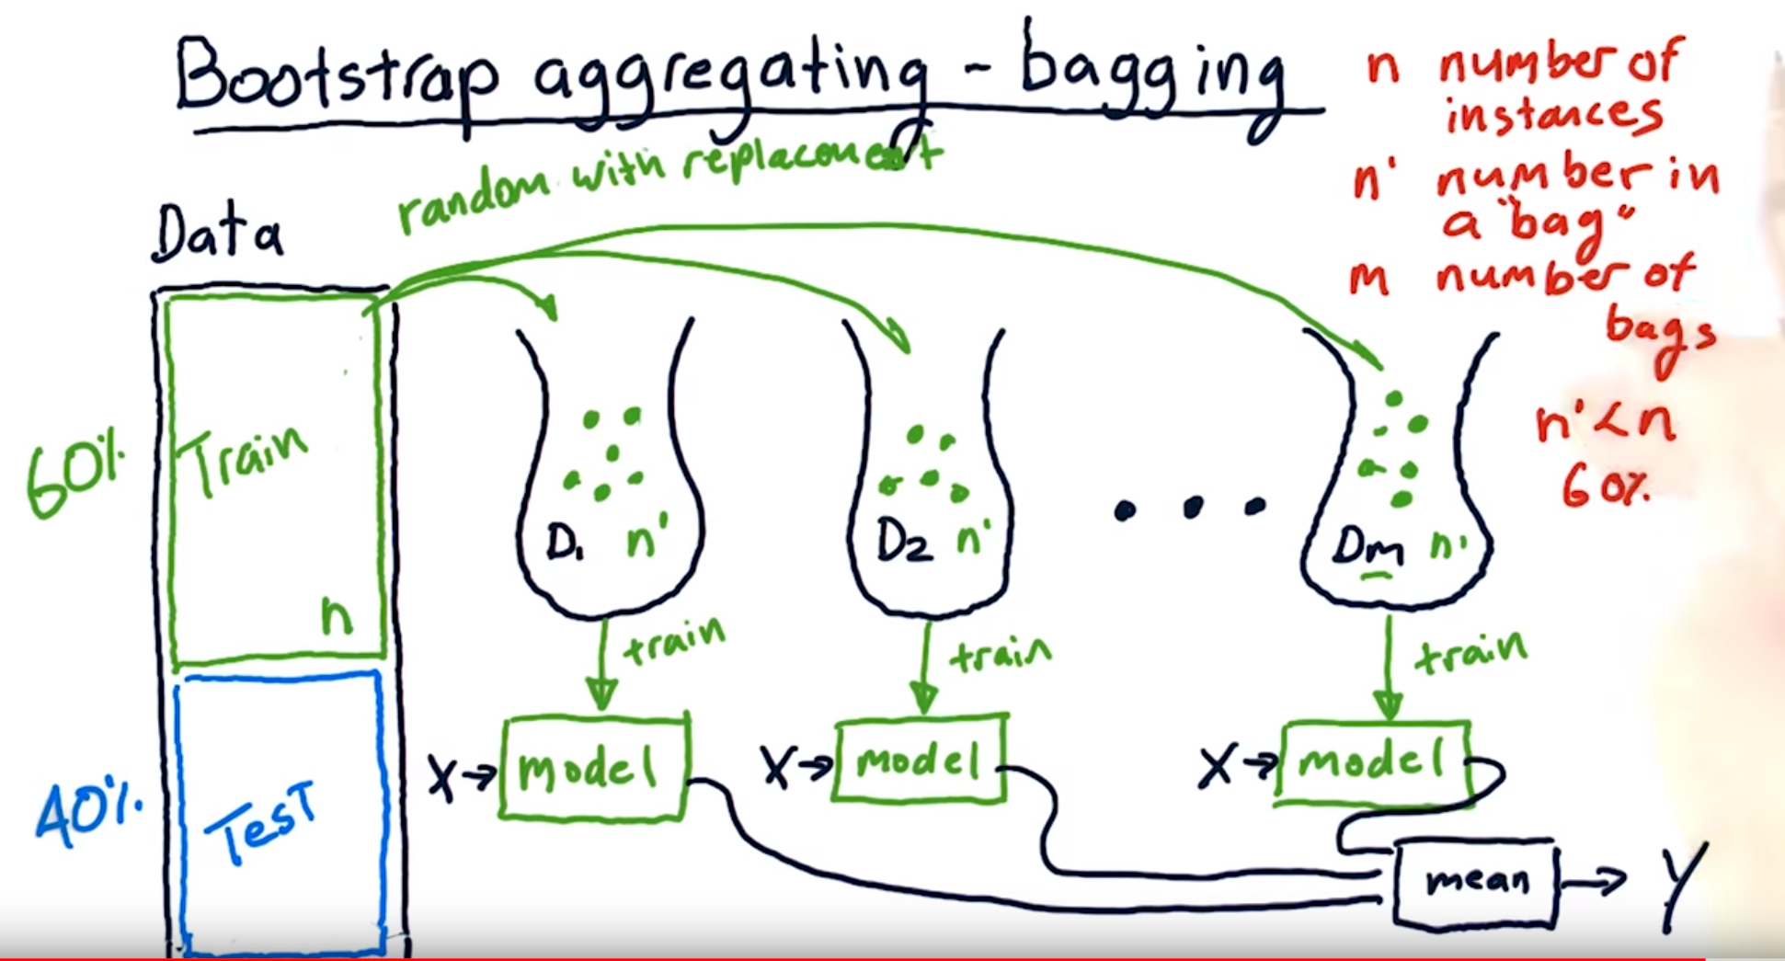
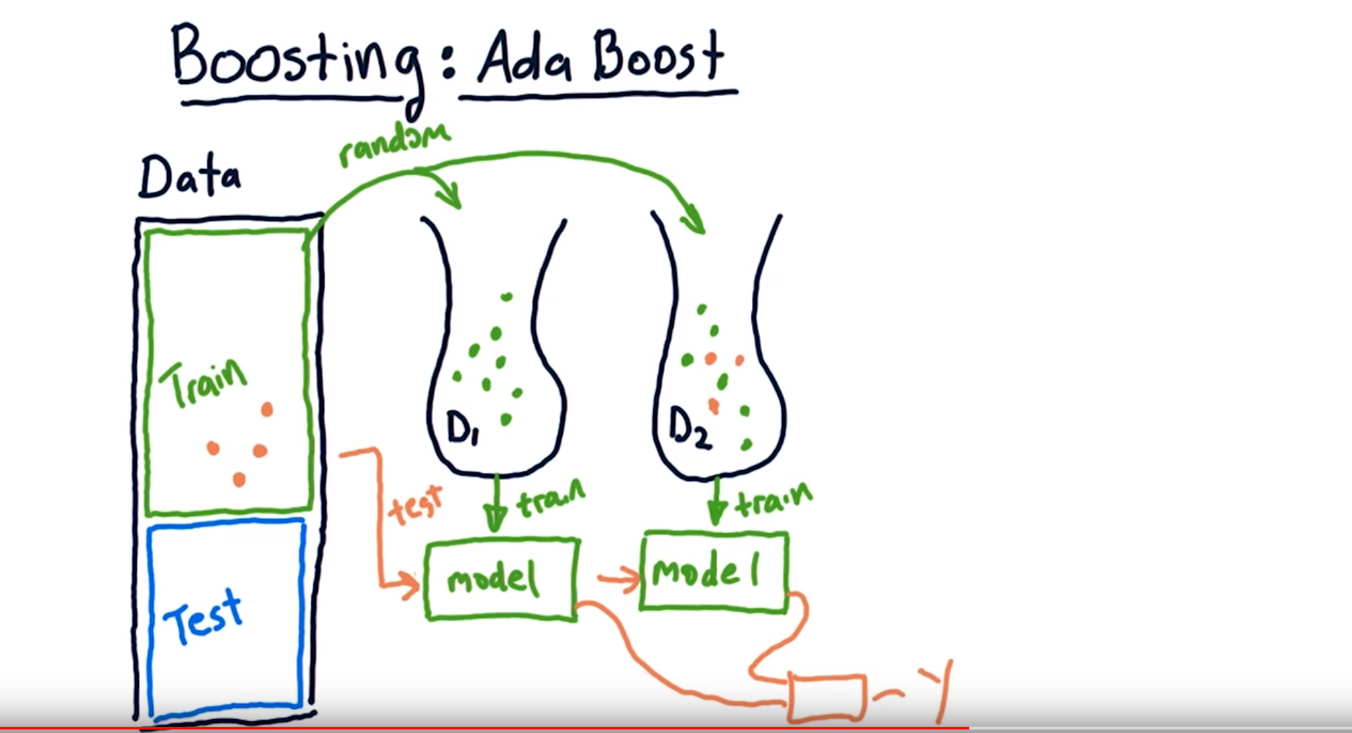


Bootstrap/Boosting

Slide 19









Slide 20








MCMC
http://newsight.tistory.com/102
https://youtu.be/SAknTVJ16r4
http://www.4four.us/article/2014/11/markov-chain-monte-carlo
https://ko.coursera.org/learn/probabilistic-graphical-models-2-inference/lecture/NkP41/gibbs-sampling
http://groups.csail.mit.edu/vision/sli/projects.php?name=shape_sampling

Slide 21



Convolution arithmetic
Zero padding은 왜 할까? Convolution 전/후 image의 크기를 유지하기 위함일까? Image의 경계면의 정보까지 살리기 위함이라는 것도 유념하자

Slide 22


Transfer Learning with CNN

Slide 23


Back propagation
http://home.agh.edu.pl/~vlsi/AI/backp_t_en/backprop.html

Slide 24

Linear Classifier

Slide 25


합성 신경망 Convolutional Neural Network (CNN)
Convolution layer + Pooling == creating feature maps == feature extraction?
Fully connected network == classification?

Slide 26

CNN – LeNet-5 (1998)

Slide 27





CNN – AlexNet(supervision) 2012
AlexNet significantly outperformed all the prior competitors and won the challenge by reducing the top-5 error from 26% to 15.3%.

Slide 28




CNN – ZFNet (2013)
It achieved a top-5 error rate of 14.8% which is now already half of the prior mentioned non-neural error rate. It was mostly an achievement by tweaking the hyper-parameters of AlexNet while maintaining the same structure with additional Deep Learning elements as discussed earlier in this essay.

Slide 29








GoogLeNet (2014)
This was very close to human level performance which the organizers of the challenge were now forced to evaluate.
The network used a CNN inspired by LeNet but implemented a novel element which is dubbed an inception module.
It used batch normalization, image distortions and RMSprop. This module is based on several very small convolutions in order to drastically reduce the number of parameters.
Their architecture consisted of a 22 layer deep CNN but reduced the number of parameters from 60 million (AlexNet) to 4 million.

Slide 30




VGGNet (2014)
VGGNet consists of 16 convolutional layers and is very appealing because of its very uniform architecture. Similar to AlexNet, only 3x3 convolutions, but lots of filters.
The weight configuration of the VGGNet is publicly available and has been used in many other applications and challenges as a baseline feature extractor. However, VGGNet consists of 138 million parameters, which can be a bit challenging to handle.

Slide 31




ResNet (2015)
at the ILSVRC 2015, the so-called Residual Neural Network (ResNet) by Kaiming He et al introduced a novel architecture with “skip connections” and features heavy batch normalization.
Such skip connections are also known as gated units or gated recurrent units and have a strong similarity to recent successful elements applied in RNNs.
Thanks to this technique they were able to train a NN with 152 layers while still having lower complexity than VGGNet. It achieves a top-5 error rate of 3.57% which beats human-level performance on this dataset.

Slide 32
ResNet

Slide 33
참고문헌
http://cs231n.stanford.edu/
http://emergent-enterprise.com/2016/10/why-deep-learning-is-suddenly-changing-your-life-part-ii/
https://beamandrew.github.io/deeplearning/2017/02/23/deep_learning_101_part1.html
https://www.slideshare.net/xavigiro/deep-learning-for-computer-vision-14-image-analytics-lasalle-2016
Andrew Ng, Coursera
https://medium.com/@siddharthdas_32104/cnns-architectures-lenet-alexnet-vgg-googlenet-resnet-and-more-666091488df5
https://laonple.blog.me
http://darkpgmr.tistory.com/132
https://www.udacity.com/course/ud730

Slide 34


ImageNet 이란?

Slide 35





Slide 36







